Slide 1


EPG Committee - PFAS Regulation
Notes:
This Baker Hughes overview deck is designed for you to customize and use with internal and external audiences. You can use the deck as it is, or customize it with additional product or business-specific slides from the online Presentation Builder library. Speaker notes are included to help you explain the value proposition of our new Baker Hughes brand.

Slide 2
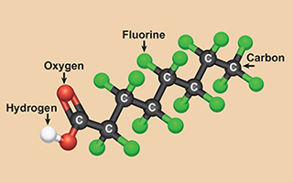
EPG PFAS Committee
Per- and polyfluoroalkyl substances
(PFAS) are a group of man-made chemicals, including PFOA, PFOS and GenX.
Committee is designed to meet 2-3 per year on Teams/EPG Meeting to update the Materials Community on global PFAS regulations.
What products are effected
    FKM, FFKM, FEPM, PFA, PTFE, PVDF
Potential impact of PFAS regulations
    ECCHA – Europe
    EPA – US
    Asia
Time line
    Important Dates on regulation implementation
      Full Ban, 13 Year derogation, Exemption ?
Alternate approaches to PFAS

Slide 3
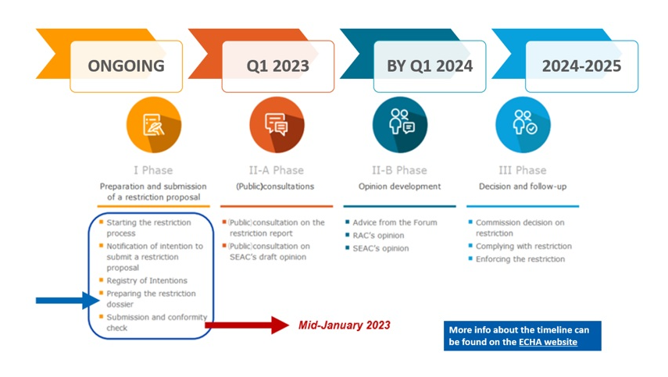
Regulatory Timeline

